Slide 1
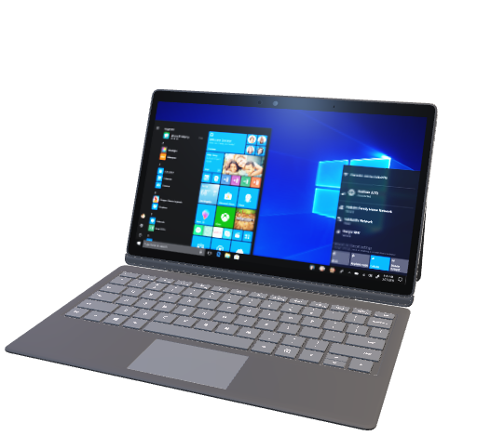
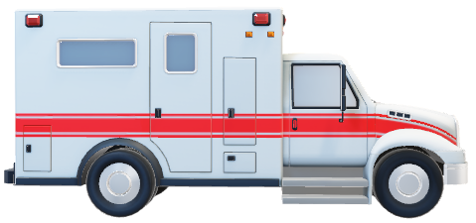
Digitalization of Doctor’s Appointment
Project By-
Vansh gupta -> 21BCS7426
Harsh Yadav -> 21BCS7668
Shivam Kumar -> 21BCS3368
Vartika Sharma -> 21BCS2926
Veerpal Kaur -> 21BCS2729

Slide 2
What are the problems that people face when they generally go to a hospital ?
You have to stand in long queues to get your appointment.
A lot of your time will be wasted because of long lines.
Patients are confused which way to go to see a particular doctor.
All the information taken by the management is stored on big registers.
These registers are difficult to use and waste a lot of paper every day.
Even if the system is digitalized many people will have problem to use it.

Slide 3
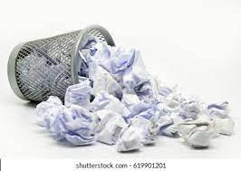
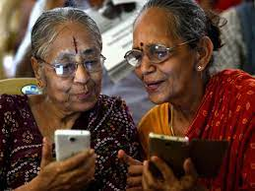
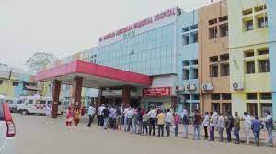
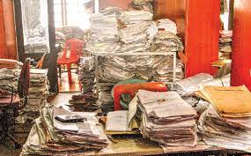

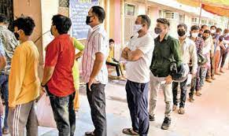
So What Is The Solution ??
DIGITALIZATION OF DOCTOR’S APPOINTMENT

Slide 4
So what are we doing to solve these problems ?
We are making a software based project on digitalization of doctor’s appointment .people can book and confirm their appointment from their houses or in the hospital premises or even on the way to the hospital or clinic.
It will give them a digital appointment slip which will have the necessary data on it and patients can show their E- slips to doctors through their smartphones.
Each E-slip will have a unique slip number which the doctors can enter in their system and check the medical history of the patient stored in the database .
All the information collected will be stored in a database which can be referred for future use.

Slide 5
So How Will Our Project Solve these problems ?
It will terminate the problem of standing in long queues.
We focus to reduce the usage of paper as it will be more environment friendly.
People in emergency won’t have to wait to get appointment
It will reduce human labour as whole process will be online.
The user interface is very basic so that even people who don’t know much about technology can also use it.
It will be easy for hospital management to keep track and history of patients.

Slide 6
Tools used in making of this project
We used x code to write and edit the code for this project
We used MySQL for the database.
We used html for the backend of our website and CSS and JavaScript for frontend

Slide 7
Are there similar kind of products already available in the market ? Yes. so what makes our product different from those
Yes there are similar kind of products available already in the market but most of them are premium and very expensive and are used by private hospitals and clinics.
We wish that our product must be used in rural areas and government hospitals.
Our product and its user interface is very easy and simple to use which can be easily used by elderly people and people who don’t know much use of technology.
The main motive of our project is to make lives of people easier when they go to hospitals and clinics and make the system as paperless as it is possible .

Slide 8
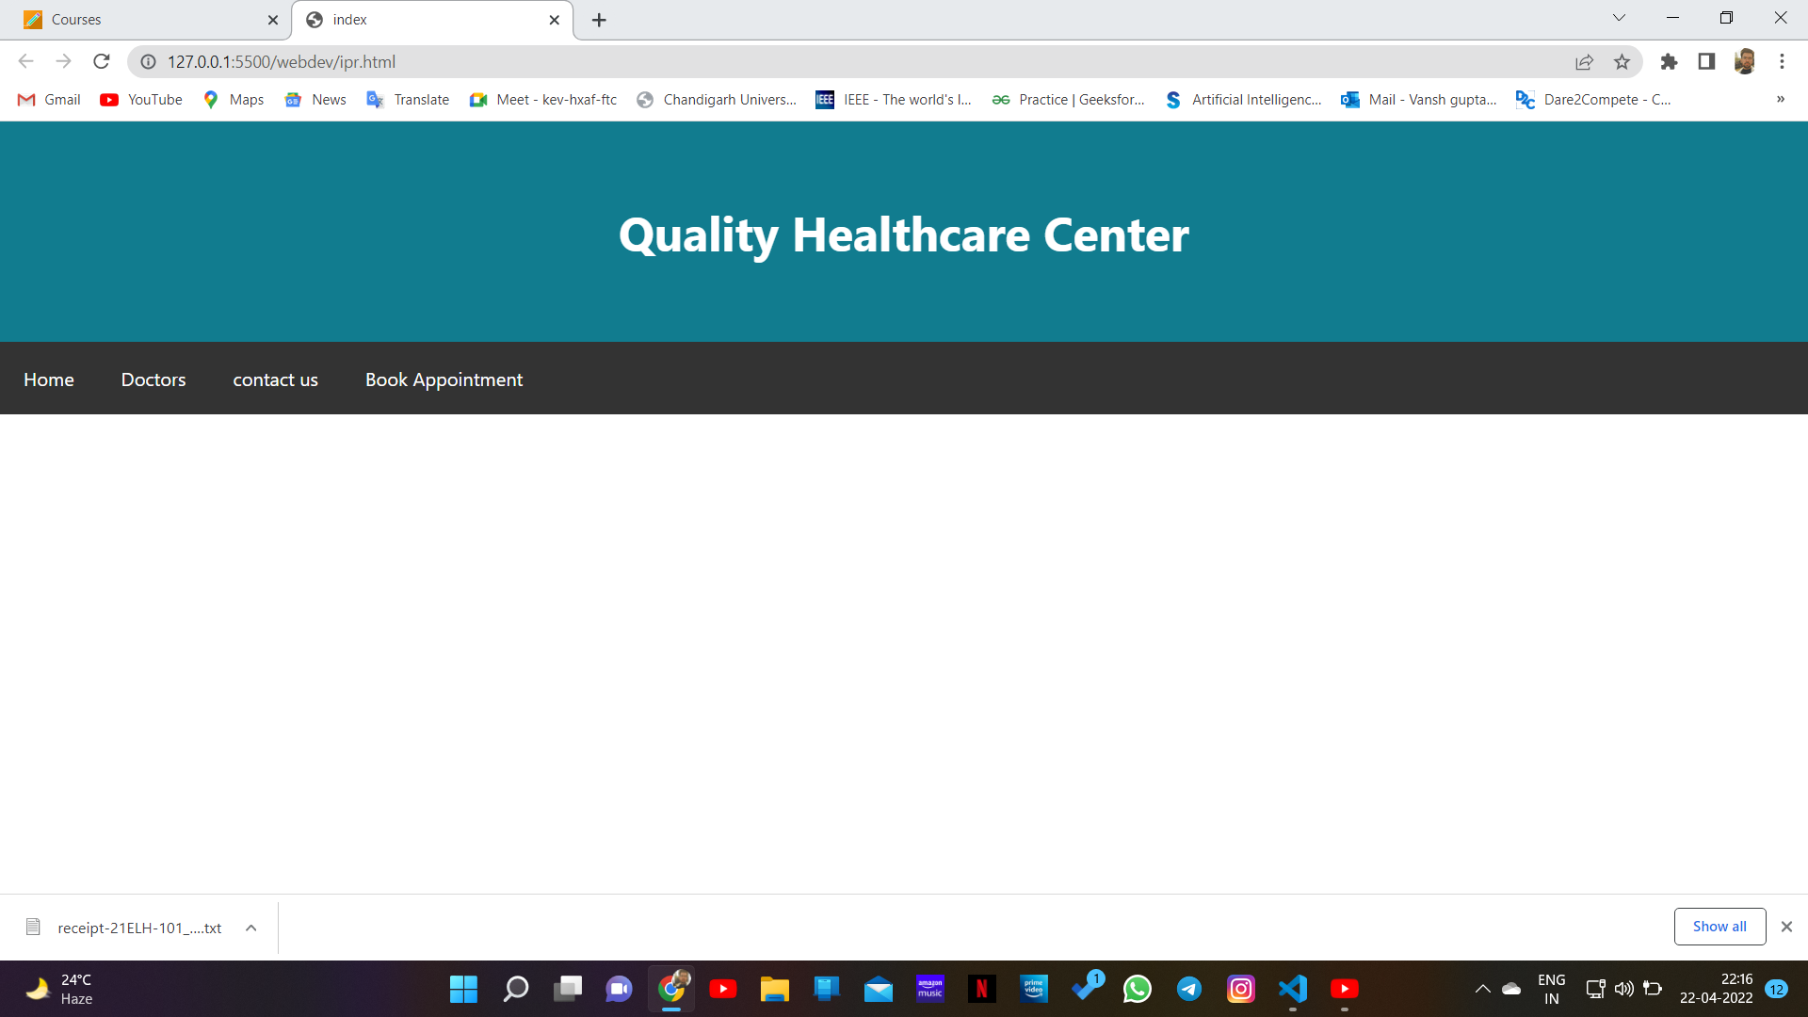
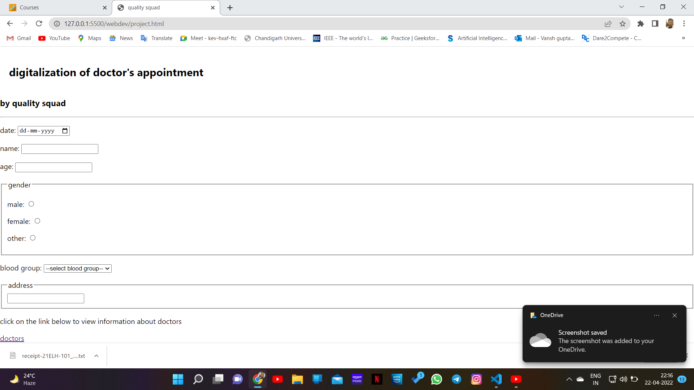
Preview of our website

Slide 9
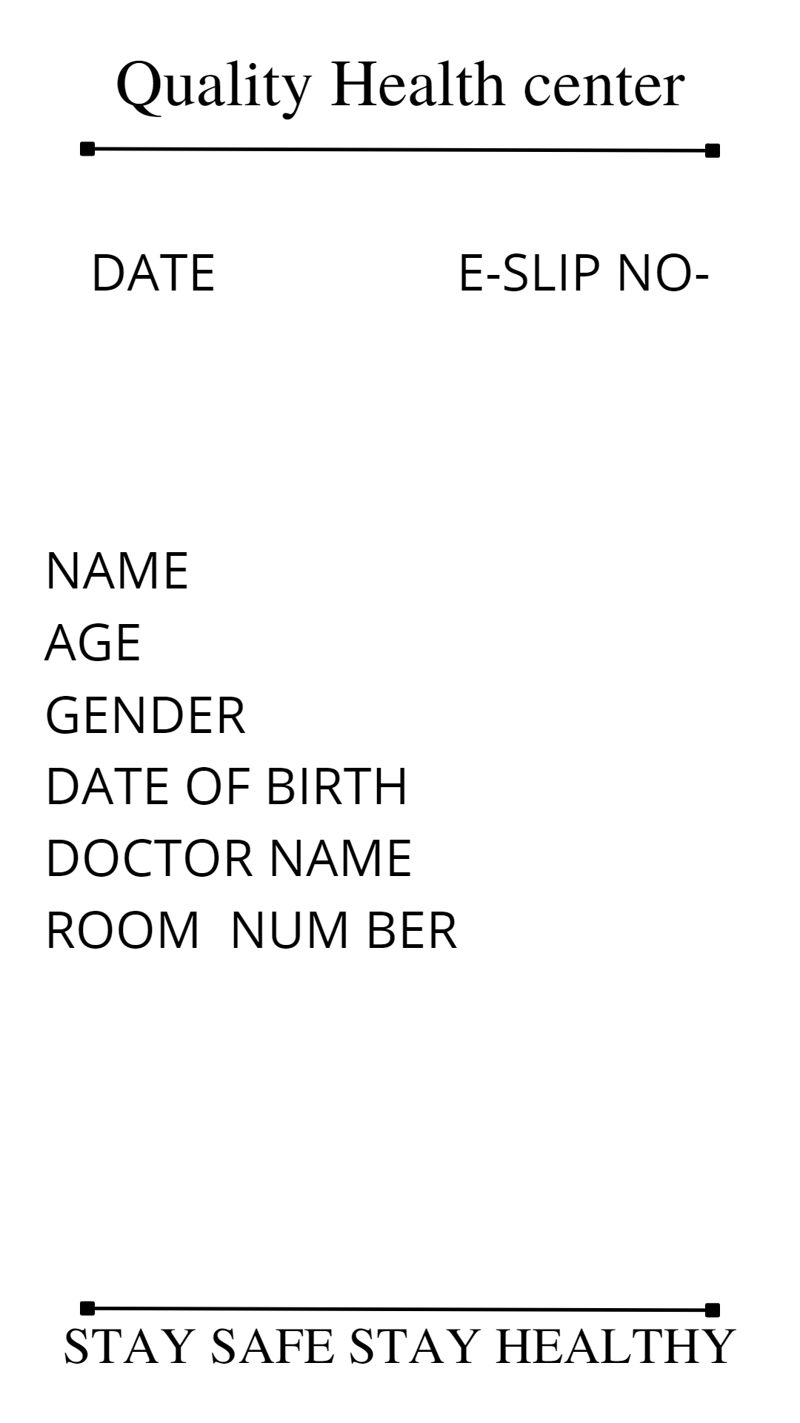
Preview of E-slip

Slide 10
Thankyou for your time

